Slide 1
Database Recovery

Slide 2
Database Recovery
In RDBMS (Relational Database Management Systems), recovery refers to the set of techniques and mechanisms used to restore a database to a correct state after a failure. It ensures that the database remains consistent, reliable, and durable, even in case of system crashes, hardware failures, or software errors.
Why Recovery is Needed?
Transaction failures – A transaction might fail due to errors in execution.
System crashes – Power failures or OS crashes can leave the database in an inconsistent state.
Media failures – Disk or storage corruption.
Application errors – Bugs that cause incorrect data changes.

Slide 3
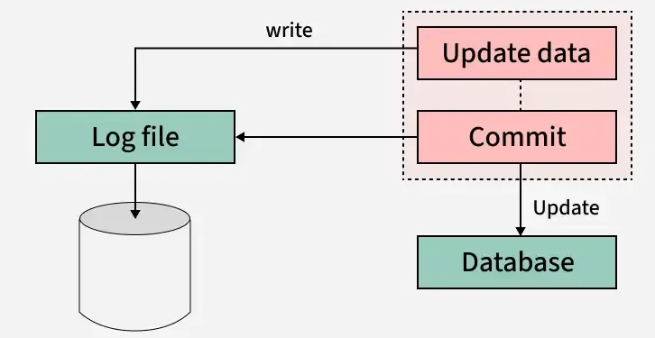
Log based Recovery technique
Log-based recovery in DBMS ensures data can be maintained or restored in the event of a system failure. The DBMS records every transaction on stable storage, allowing for easy data recovery when a failure occurs. For each operation performed on the database, a log file is created. Transactions are logged and verified before being applied to the database, ensuring data integrity.

Slide 4
Log based Recovery technique
A log is a sequence of records that document the operations performed during database transactions. Logs are stored in a log file for each transaction, providing a mechanism to recover data in the event of a failure. For every operation executed on the database, a corresponding log record is created. It is critical to store these logs before the actual transaction operations are applied to the database, ensuring data integrity and consistency during recovery processes.

Slide 5
Operations in Log-Based Recovery
Undo Operation
The undo operation reverses the changes made by an uncommitted transaction. Even though the transaction did not commit, its dirty pages may have already been written to disk from the buffer. Undo restores the old values using the log to remove these partial changes.
Example of Undo: Consider a transaction T1 that updates a bank account balance but fails before committing:
Initial State: Account balance = 500.
Transaction T1:
Update balance to 600.
Log entry:<T1, Balance, 500, 600>
Failure: T1 fails before committing.
Undo Process:
Use the old value from the log to revert the change.
Set balance back to 500.
Final log entry after undo:<T1, Abort>

Slide 6
Operations in Log-Based Recovery
Redo Operation
The redo operation re-applies the changes of a committed transaction. Although the transaction has committed, its updated pages may not have been flushed to disk before the crash. Redo ensures that committed changes are safely applied to the database.
Example of Redo: Consider a transaction T2 that updates an account balance but the database crashes before changes are permanently reflected:
Initial State: Account balance = 300.
Transaction T2:
Update balance to 400.
Log entries:<T2, Start><T2, Balance, 300, 400><T2, Commit>
Crash: Changes are not reflected in the database.
Redo Process:
Use the new value from the log to reapply the committed change.
Set balance to 400.

Slide 7
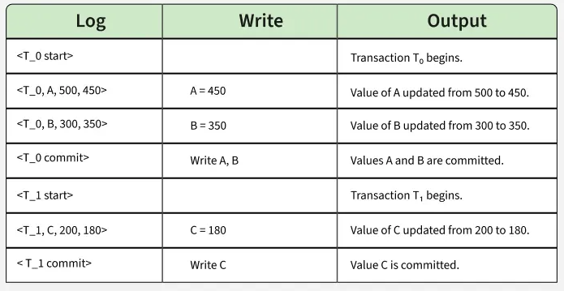
Methods of Log
Immediate Modification
In the Immediate Modification method, the database is updated as soon as a change is made during a transaction, even before the transaction is committed. Logs are written before making any changes to ensure recovery is possible in case of a system failure.

Slide 8
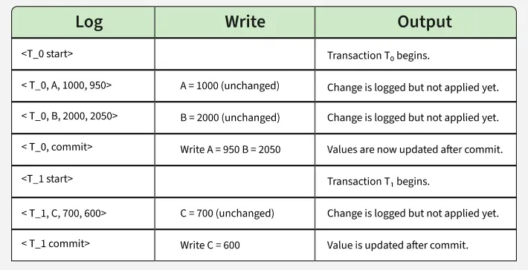
Methods of Log
Deferred Modification:
In the Deferred Modification method, changes to the database are not applied immediately. Instead, they are logged and stored temporarily. The database is only updated after the transaction is fully committed. This method ensures that no partial changes are made to the database, reducing the risk of inconsistency.

Slide 9
Timestamp-Based Protocols
The most commonly used concurrency protocol is the timestamp based protocol. This protocol uses either system time or logical counter as a timestamp.
Lock-based protocols manage the order between the conflicting pairs among transactions at the time of execution, whereas timestamp-based protocols start working as soon as a transaction is created.
Every transaction has a timestamp associated with it, and the ordering is determined by the age of the transaction. A transaction created at 0002 clock time would be older than all other transactions that come after it. For example, any transaction 'y' entering the system at 0004 is two seconds younger and the priority would be given to the older one.
In addition, every data item is given the latest read and write-timestamp. This lets the system know when the last ‘read and write’ operation was performed on the data item.

Slide 10
Timestamp-Based Protocols
Timestamp ordering protocolworks as follows −
If a transactionTi issues a read(X) operation
If TS(Ti) < W-TS(X)
Operation rejected.
If TS(Ti) >= W-TS(X)
Operation executed.
All data-item timestamps updated.
If a transactionTi issues a write(X)operation −
If TS(Ti) < R-TS(X)
Operation rejected.
If TS(Ti) < W-TS(X)
Operation rejected and Ti rolled back.
Otherwise, operation executed.

Slide 11
Checkpoints
A checkpoint marks a point in time where the DBMS ensures that the database is in a consistent state and all prior transactions have been committed. During transaction execution, these checkpoints are recorded periodically.
After a checkpoint is reached:
The transaction log up to that point can be safely discarded, as all corresponding updates have already been written to the database.
A new log file is then created to record changes from subsequent transactions.
This process continues, allowing the system to limit the amount of log data and improve recovery efficiency by avoiding scanning the entire log history.

Slide 12
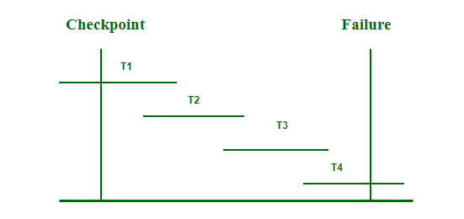
Checkpoints
Steps to Use Checkpoints in the Database
Write the begin_checkpoint record into a log.
Collect checkpoint data in stable storage.
Write the end_checkpoint record into a log.

Slide 13
Shadow paging
Shadow paging is a recovery technique used in DBMS to ensure that transactions are atomic (all-or-nothing) and durable (changes survive failures). Instead of keeping detailed logs like log-based recovery, shadow paging maintains two versions of the database’s page table:
1. Shadow Page Table
Represents the old, stable state of the database (before the transaction begins).
It never changes during the transaction.
If a failure occurs, the system can immediately revert to this version.
2. Current Page Table
A copy of the shadow page table made when a transaction starts.
All updates during the transaction are made here.
Only modified pages are replaced with new pages—this is known as copy-on-write or out-of-place updating.

Slide 14
Algorithm for Recovery and Isolation Exploiting Semantics (ARIES)
ARIES is a robust recovery algorithm based on the Write-Ahead Logging (WAL) protocol, widely used in modern DBMS to ensure durability and consistency after system failures.
Types of Log Records in ARIES
Every update operation creates a log record, which can be of the following types:
Undo-only Log Record: Stores only the before image (original data). Used to undo changes.
Redo-only Log Record: Stores only the after image (new data). Used to redo changes.
Undo-Redo Log Record: Stores both before and after images. Used for both undo and redo operations.
Log Sequence Numbers (LSN)
Every log record is assigned a unique, monotonically increasing LSN.
Every data page has a pageLSN indicating the LSN of the last update applied to it.
Write-Ahead Logging (WAL) Rules
A log record must reach stable storage before the corresponding data page is written to disk.
Log writes are buffered in a memory area called the log tail.
The log tail is flushed to disk when full.
A transaction is not considered committed until its commit record is flushed to disk.

Slide 15
Recovery With Concurrent Transactions
Concurrency control means that multiple transactions can be executed at the same time and then the interleaved logs occur. But there may be changes in transaction results so maintain the order of execution of those transactions. During recovery, it would be very difficult for the recovery system to backtrack all the logs and then start recovering. Recovery with concurrent transactions can be done in the following four ways.Interaction with concurrency control
Transaction rollback
Checkpoints
Restart recovery

Slide 16
Thomas Writes rule
Thomas Write Rule is a concurrency control technique used in DBMS to manage concurrent transactions efficiently. It extends the traditional timestamp-ordering protocol by introducing conditions where outdated writes are ignored. It enhances the system performance while maintaining data consistency.

Slide 17
Rules:
If TS(Ti) < R(Q)
TS(Ti) is the timestamp of transaction Ti, and R(Q) is the last read timestamp of data Q.
If TS(Ti) is less than R(Q),
it means the value Q created by Ti was already needed but was never produced. In this case, Ti
is rolled back.
If TS(Ti) < W(Q)
W(Q) is the last write timestamp of Q.
If TS(Ti) is less than W(Q),
Ti is writing an outdated value, so its write operation is ignored.
Otherwise −
If neither of the above conditions applies, the write operation proceeds. Here the W(Q) is updated to TS(Ti)

